Slide 1
Constraints LAB3

Slide 2
Constraints addition, deletion and modify
1.Create a table without any constraints
Student – regno varchar2(10),name varchar2(10), dob date, email_id varchar2(10), country varchar2(10),gender varchar2(3));
Desc student;
increase the width of a VARCHAR column
ALTER TABLE student ALTER name SET DATA TYPE VARCHAR(30);
Desc student;
Primary key →regno
Add a primary key with a constraint name
ALTER TABLE student ADD CONSTRAINT pk_regnumberPRIMARY KEY(regno);
SELECT COLUMN_NAME, CONSTRAINT_NAM, CONSTRAINT_TYPEE FROM user_constraints WHERE table_name = ‘STUDENT‘;
Drop primary key
ALTER TABLE student DROP CONSTRAINT pk_regnumber;
SELECT COLUMN_NAME, CONSTRAINT_NAME, CONSTRAINT_TYPE FROM user_constraints WHERE table_name = ‘STUDENT‘;
For adding composite primary key
ALTER TABLE student ADD CONSTRAINT pk_regno_name PRIMARY KEY(regno,name);
SELECT COLUMN_NAME, CONSTRAINT_NAME, CONSTRAINT_TYPE FROM user_constraints WHERE table_name = ‘STUDENT‘;

Slide 3
Unique key– email_id
Add a unique key constraint with a name
ALTER TABLE student ADD CONSTRAINT email_uk UNIQUE (email_id);
SELECT COLUMN_NAME, CONSTRAINT_NAME, CONSTRAINT_TYPE FROM user_constraints WHERE table_name = ‘STUDENT‘;
Drop the unique key constraint
ALTER TABLE supplier DROP CONSTRAINT email_uk;
SELECT COLUMN_NAME, CONSTRAINT_NAME, CONSTRAINT_TYPE FROM user_constraints WHERE table_name = ‘STUDENT‘;
Create a unique constraint with more than one field as in the example below:
no two rows in the table can have the same combination of values in the key columns.
Any row that contains nulls in all key columns automatically satisfies the constraint.
However, two rows that contain nulls for one or more key columns and the same combination of values for the other key columns violate the constraint.
SYNTAX:- ALTER TABLE student ADD CONSTRAINT name_email_uk UNIQUE (name, email_id);
SELECT COLUMN_NAME, CONSTRAINT_NAME , CONSTRAINT_TYPE FROM user_constraints WHERE table_name = ‘STUDENT‘;

Slide 4
Check constraint- dob > 1/1/2010 , gender =‘M’/’F’/’O’
Add a check constraint with dob and gender
ALTER TABLE student ADD CONSTRAINT check_dob_gender CHECK (dob>’01-jan-2010’ and gender IN (‘M’, ‘F’, ‘O’));
SELECT COLUMN_NAME, CONSTRAINT_NAME, CONSTRAINT_TYPE FROM user_constraints WHERE table_name = ‘STUDENT‘;
Drop the check constraint
ALTER TABLE student DROP CONSTRAINT check_dob_gender;
SELECT COLUMN_NAME, CONSTRAINT_NAME, CONSTRAINT_TYPE FROM user_constraints WHERE table_name = ‘STUDENT‘;
Enable check constraint
ALTER TABLE student ENABLE CONSTRAINT check_dob_gender;
Disable check constraint
ALTER TABLE student DISABLE CONSTRAINT check_dob_gender;

Slide 5
DEFAULT constraint –country =‘india’
Add a default constraint
alter table student modify country default ‘India’;
SELECT COLUMN_NAME, CONSTRAINT_NAME, CONSTRAINT_TYPE FROM user_constraints WHERE table_name = ‘STUDENT‘;
Drop the default constraint
ALTER TABLE student ALTER COLUMN City DROP DEFAULT;
SELECT COLUMN_NAME, CONSTRAINT_NAME, CONSTRAINT_TYPE FROM user_constraints WHERE table_name = ‘STUDENT‘;
Add a new colum with a default value
ALTER TABLE Sstudent ADD COLUMN DEPTNO INT DEFAULT ‘SCSE’;
SELECT COLUMN_NAME, CONSTRAINT_NAME , CONSTRAINT_TYPE FROM user_constraints WHERE table_name = ‘STUDENT‘;

Slide 6
Not null – name and dob
Add a not null constraint
ALTER TABLE student MODIFY (name NOT NULL);
ALTER TABLE Persons MODIFY (dob NOT NULL);
SELECT COLUMN_NAME, CONSTRAINT_NAME, CONSTRAINT_TYPE FROM user_constraints WHERE table_name = ‘STUDENT‘;
drop the not null constraint
ALTER TABLE student MODIFY (name NULL);
SELECT COLUMN_NAME, CONSTRAINT_NAME, CONSTRAINT_TYPE FROM user_constraints WHERE table_name = ‘STUDENT‘;

Slide 7
How to Create an Auto Increment Field Using Sequence
First, let’s create an emp table with primary key constraint on emp_id column.
SQL> create table emp ( emp_id number(10), fname varchar2(25), lname varchar2(25), constraint pk_emp_id PRIMARY KEY(emp_id) );
Now let’s create a sequence.
SQL> Create sequence emp_sequence start with 1 increment by 1 minvalue 1 maxvalue 10000
Now let’s insert the values into emp table.
SQL> insert into emp (emp_id,fname,lname) values(emp_sequence.nextval,'Darvin','Johnson');
SQL> select * from emp;

Slide 8
SQL Foreign key or Referential Integrity :
This constraint identifies any column referencing the PRIMARY KEY in another table.
It establishes a relationship between two columns in the same table or between different tables.
For a column to be defined as a Foreign Key, it should be a defined as a Primary Key in the table which it is referring.
One or more columns can be defined as Foreign key.
Syntax to define a Foreign key at column level:
[CONSTRAINT constraint_name] REFERENCES Referenced_Table_name(column_name)

Slide 9
Syntax to define a Foreign key at table level:
[CONSTRAINT constraint_name] FOREIGN KEY(column_name) REFERENCES referenced_table_name(column_name);
For Example:
1) Lets use the "product" table and "order_items". Foreign Key at column level:
CREATE TABLE product ( product_id number(5) CONSTRAINT pd_id_pk PRIMARY KEY, product_name char(20), supplier_name char(20), unit_price number(10) );

Slide 10
CREATE TABLE order_items ( order_id number(5), product_id number(5), product_name varchar2(20), supplier_name varchar2(20), unit_price number(10), CONSTRAINT od_id_pk PRIMARY KEY(order_id), CONSTRAINT pd_id_fk FOREIGN KEY(product_id) REFERENCES product(product_id) );
SELECT COLUMN_NAME, CONSTRAINT_NAME, CONSTRAINT_TYPE FROM user_constraints WHERE table_name = ‘ORDER_ITEMS‘;
Drop the foreign key constraint
ALTER TABLE products DROP CONSTRAINT pd_id_fk;
SELECT COLUMN_NAME, CONSTRAINT_NAME, CONSTRAINT_TYPE FROM user_constraints WHERE table_name = ‘order_items‘;
Add a foreign key constraint
ALTER TABLE ORDER_ITEMS ADD CONSTRAINT pd_id_fk FOREIGN KEY(product_id) REFERENCES product(product_id);
SELECT COLUMN_NAME, CONSTRAINT_NAME, CONSTRAINT_TYPE FROM user_constraints WHERE table_name = ‘ORDER_ITEMS‘;

Slide 11
Creating Indexes
In addition to primary keys, you can create indexes to provide fast access to any column or combination of columns you want.
You create indexes with the CREATE INDEX statement:
CREATE INDEX index_name ON table_name (index_key_columns)
For example, to create an index on the AUTHOR_NAME column in the BOOKS table, the online bookstore would use
CREATE INDEX author_name ON books (author_name)→dense index
By default, the index will allow duplicate entries and sort the entries in ascending order.
To require unique index entries, add the keyword UNIQUE after CREATE:
CREATE UNIQUE INDEX author_name ON books (author_name)→sparse Index

Slide 12
Insert & Delete records into and from table
INSERT INTO Customers VALUES ('Cardinal','Tom B. Erichsen','Skagen 21','Stavanger','4006','Norway');
Insert Data Only in Specified Columns
INSERT INTO Customers (CustomerName, City, Country) VALUES ('Cardinal', ‘ ‘, ‘India');
UPDATE Customers SET City = ‘Chennai’ whereCity = ‘India’;
Insert into Customers values(‘&name’,’&city’,’&country’);
>/
DELETE FROM customers WHERE last_name = 'Smith‘;

Slide 13
Delete https://www.databasestar.com/oracle-constraints/
ON DELETE SET NULL: When you delete the parent record, then all child records will have the referenced column set to NULL.
ON DELETE CASCADE: When you delete the parent record, then all child records will be deleted as well.
CREATE TABLE employee ( employee_id NUMBER(10), first_name VARCHAR2(200), last_name VARCHAR2(200), salary NUMBER(10), hire_date DATE, department_id NUMBER(10), CONSTRAINT fk_emp_deptid FOREIGN KEY (department_id) REFERENCES department(dept_id) ON DELETE SET NULL );

Slide 14
DELETE FROM department WHERE department_id = 3;
1 row deleted.
Our employee table will now look like this. Employee ID 2, which used to have a department ID of 3, now has a department ID of null. This is because department ID 3 was deleted, so all related records are set to null.

Slide 15
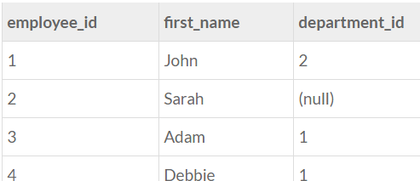

Slide 16
CREATE TABLE employee ( employee_id NUMBER(10), first_name VARCHAR2(200), last_name VARCHAR2(200), salary NUMBER(10), hire_date DATE, department_id NUMBER(10), CONSTRAINT fk_emp_deptid FOREIGN KEY (department_id) REFERENCES department(dept_id) ON DELETE CASCADE );

Slide 17
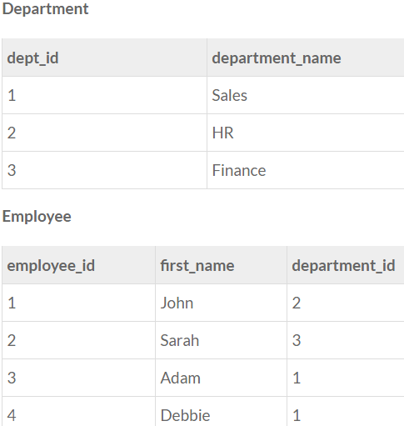

Slide 18
Now, let’s delete department 3 again, and see what happens.
DELETE FROM department WHERE department_id = 3; 1 row deleted.
Our employee table will now look like this. Employee ID 2, which used to have a department ID of 3, is now removed form the table entirely.

Slide 19
